Slide 1

Introduction to Operating Systems CS/COE 1550
Fall 2021
Sherif Khattab
ksm73@pitt.edu
(Some slides are from Silberschatz, Galvin and Gagne ©2013)

Slide 2
Announcements
Homework 1 is due this Friday at 11:59 pm
Recitations started last week
Please watch the videos
Lab 1 is due on 9/20 at 11:59 pm
Using GitHub Classroom
Explained in this week’s recitation
Steps of a Syscall in detail on Canvas
TA Office hours available on the syllabus page

Slide 3
What happens on a syscall?
System call invocation is very expensive!
Don’t make unnecessary syscalls in your applications.
2
1
7
6
12
1
eax <-- 1
10
3
int 64
5
4
11
8
9

Slide 4
Muddiest Points (1/2)
Does each syscall and/or interrupt essentially cause a context switch? Also the code at the end was a bit confusing, is main.c what cpu begins executing on boot up?
How and why do we pass parameters to the OS
Are the functions in the hardware picture all pointed to by the IDT or are there other functions in there (like one for each syscall) & also Syscall Parameter Passing
The IDT initialization is a bit weird.
Are all interrupts syscalls but not all syscalls are interrupts?
So is a syscall just like an interrupt, except with more possible functions to chose from?
IDT is a little confusing, does it work similar to the syscall table, but with all interrupts?
Adding new syscalls
Why are f8() and f9() able to add a syscall?

Slide 5
Muddiest Points (2/2)
What is the kernal mode actually used for? As in, what is its purpose as opposed to keeping the CPU in one mode
Can you go over what trap does again?
Since interrupts are electric signals, is it possible to overload/harm a CPU with too many interrupts? Also, what makes one CPU more powerful than an another: is it related to the amount of interrupts it can handle or how many cores it has?
is it easy for virus to gain access to kernel mode?
Can you only have as many system calls as the idt can store?
Are there any differences in speed between software and hardware interrupts?
Why does the idt increase the number of memory accesses for a syscall by pointing to a function that calls the syscall, instead of pointing directly to the syscall? i.e. why isn't the syscall table just a section in the idt?
Is the interrupt # always the same regardless of which piece of hardware?
The atomic part or the differences of interrupts that can be interrupted
How a boot virus works
What is the biggest difference between the System Call table and the IDT? They both provide addresses for interrupt service routines?
I'm curious why you would want to add a new syscall and if there is a limit to the amount of these that could be added

Slide 6
Xv6 Code Walkthrough
IDT table initialization
Syscall table
How a syscall is invoked
Syscall implementation
Parameter passing into a syscall
In Lab 1 you will add a system call to Xv6

Slide 7
Operating System Structure
General-purpose OS is very large program
Various ways to structure an OS:
Simple structure – MS-DOS
More complex – UNIX
Layered – an abstraction
Microkernel – Mach

Slide 8
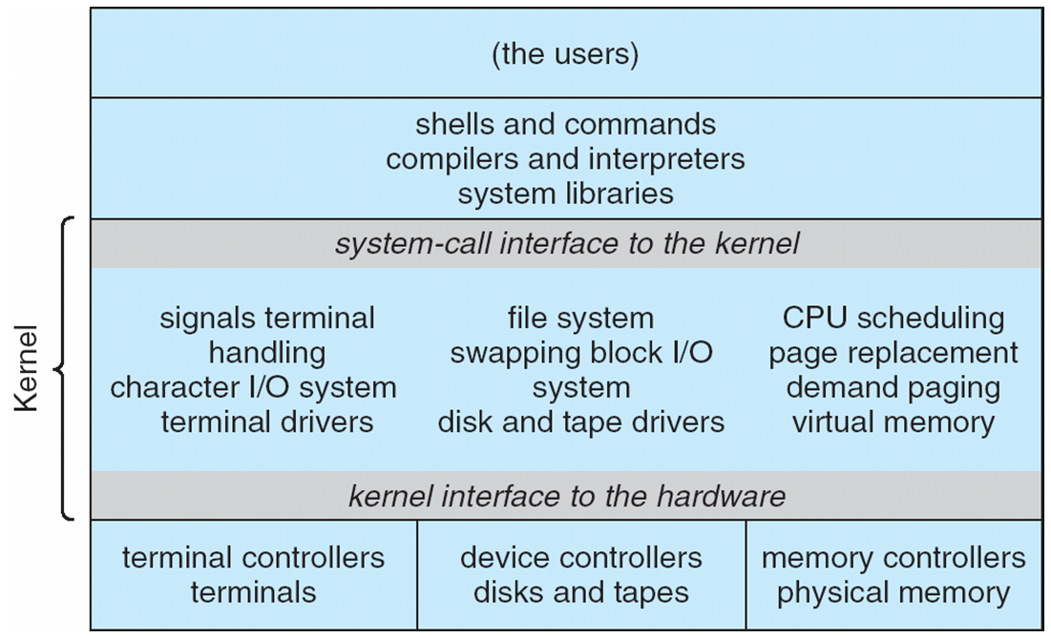
Traditional UNIX System Structure
Beyond simple but not fully layered

Slide 9
Microkernel System Structure

Slide 10
Process Concept
An operating system executes a variety of programs:
Batch system – jobs
Time-shared systems – user programs or tasks
Process – a program in execution; process execution must progress in sequential fashion
Multiple parts
The program code, also called text section
Current activity including program counter, processor registers
Stack containing temporary data
Function parameters, return addresses, local variables
Data section containing global variables
Heap containing memory dynamically allocated during run time

Slide 11
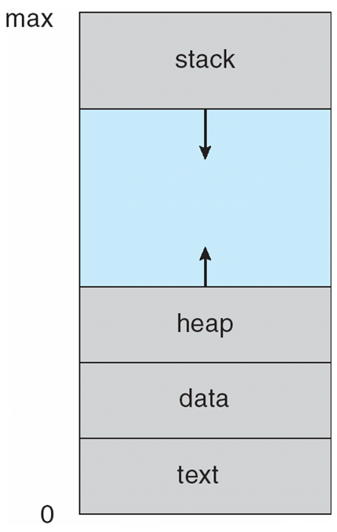
Process in Memory

Slide 12
Process State
As a process executes, it changes state
new: The process is being created
running: Instructions are being executed
waiting: The process is waiting for some event to occur
ready: The process is waiting to be assigned to a processor
terminated: The process has finished execution

Slide 13
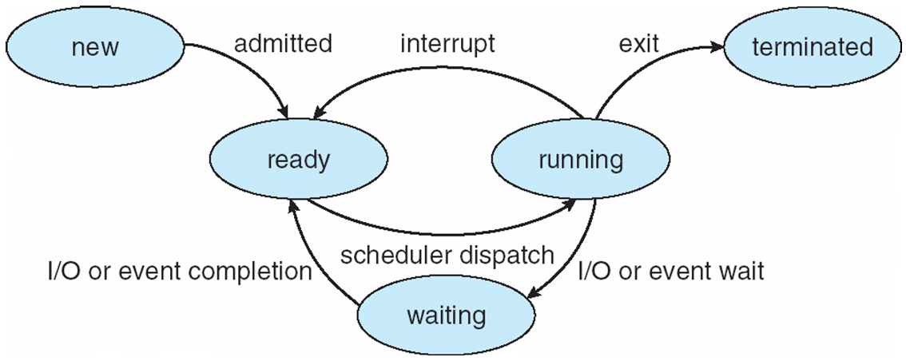
Diagram of Process State

Slide 14
Process Control Block
``Active entities are data structures when viewed from a lower level.’’
Raphael Finkel, University of Kentucky

Slide 15
Process Control Block (PCB)
Information associated with each process
(also called task control block)
Process state – running, waiting, etc
Program counter – location of instruction to execute next
CPU registers – contents of all process-centric registers
CPU scheduling information- priorities, scheduling queue pointers
Memory-management information – memory allocated to the process
Accounting information – CPU used, clock time elapsed since start, time limits
I/O status information – I/O devices allocated to process, list of open files

Slide 16
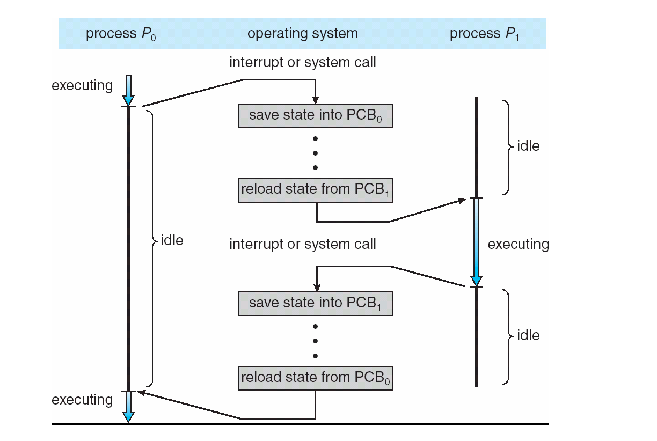
Context Switching

Slide 17
Context Switch
When CPU switches to another process, the system must save the state of the old process and load the saved state for the new process via a context switch
Context of a process represented in the PCB
Context-switch time is overhead; the system does no useful work while switching
The more complex the OS and the PCB ➔ the longer the context switch
Time dependent on hardware support
Some hardware provides multiple sets of registers per CPU ➔ multiple contexts loaded at once

